Slide 1

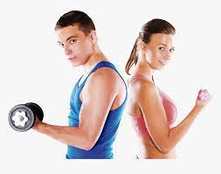
al
Welcome to Gym Fitness.
Transform yourself with personalize plans that evolve as you go.
Get Started
Already have an account

Slide 2
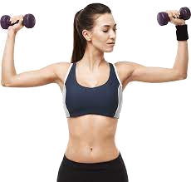
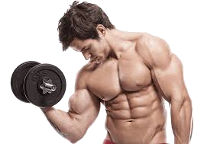
What’s your gender?
Female
Male

Slide 3
What’s your First Name?
Shahinur
Continue

Slide 4
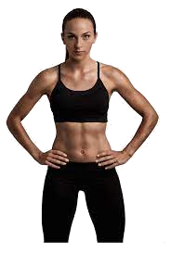
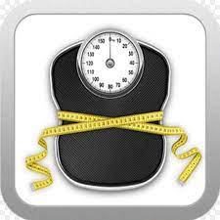
What’s your Goal?
Get Toned
Lose weight

Slide 5



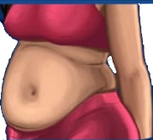
What’s your Body Type?
Hourglass
Rectangle
Rounded
Lightbulb

Slide 6
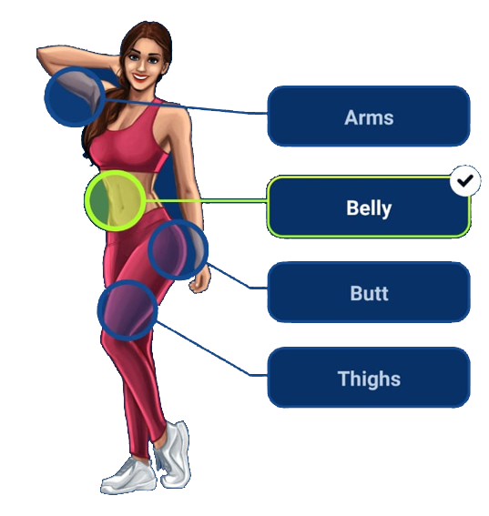
Which parts should we focus on?
Continue

Slide 7
Are you previous workout experience?
Yes, I work Yes, out regularly
Yes, less then a year ago
Yes, more than 1 year ago
No, I don’t have any

Slide 8
How fit are you?
I am very fit
I’m fit
I’m not very fit

Slide 9
How old are you?
-
24
+
Years
Continue

Slide 10
How tall are you?
-
5’3
+
cm
Ft&IN
Continue

Slide 11
How is you weight?
-
53
+
kg
Ibs
Continue

Slide 12
Alright,now your target weight?
-
54
+
kg
Ibs
Continue

Slide 13
Do you suffer from knee pain?
No
yes

Slide 14
What do your typical day look like?
Mostly walking & active
Mostly walking & active on foot
Mostly seated
At home, Mostly Inactive

Slide 15
How many push-ups can you do?
30+
15-29
6-14
Less than 5

Slide 16
How much do you walk daily?
More than 2 hours
1-2 hours
Less than 1 hour

Slide 17
Any bad habits?
I have a sweet tooth
I love sugary drinks
I enjoy fast food
I eat late at night
Continue

Slide 18
How much do you walk daily?
More than 2 hours
1-2 hours
Less than 1 hour

Slide 19
When was the last time you were t your ideal weight?
Less than a year ago
1-2 years ago
More than 2 year ago
Never
Continue

Slide 20
How much do you Sleep every night?
More than 8 hours
7-8 hours
6-7 hours
Less than 6hour

Slide 21
How often do do you feel stressed?
Not much at all
A few times a week
Multiple times a day

Slide 22
What’s your daily water intake?
More than 6 glass
3 to 6 glasses
2 glasses
I only drink soda or coffe

Slide 23
What motivates you the most
Felling confident
Being active
Improving sleep
Bosting engery
Continue

Slide 24
How motivated are you to start?
I’m motivated
I’m very motivated
Not so much

Slide 25
How long will you commit for?
At least a year
At least 3 month
At least a month

Slide 26
What pace would you prefer in your plan
At fast as possible
Balance pace
Slowly but steadily
Continue

Slide 27

Loading
Building your data

Slide 28

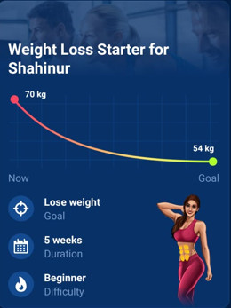
Your plan is Ready!
Continue

Slide 29
Monthly
BDTI 1,000
Yearly
BDTI 7,100
Subscribe

Slide 30
Monthly
BDTI 1,000
Yearly
BDTI 7,100
Subscribe

